Slide 1
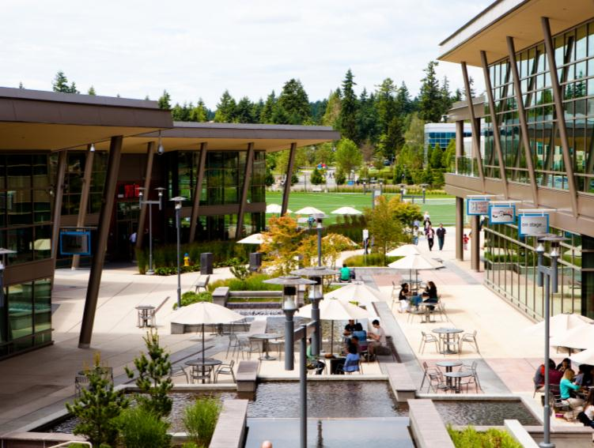

Tarun Singh Bisht
UWP for IOT Core

Slide 2
What drives us?

Slide 3
Microsoft’s Perspective on IoT
IoT is a business revolution enabled by a technology revolution
IoT enables a “digital feedback loop”
This digital feedback loop connects
Businesses to products to customers, enabling better products and customer insights
Businesses to assets, enabling transformational optimization
Digital Feedback Loop
Products
& Assets
Businesses

Slide 4
IOT Example
Knowing if elevators are not operational before customers do
Knowing the maintenance needs, saving 50% of servicing
Knowing the right part to bring the first time
4x reduction in the time spent servicing an elevator using HoloLens
Digital Feedback Loop
Products
& Assets
Businesses

Slide 5
Microsoft’s Perspective on IoT
IoT is a massive opportunity for developers
Microsoft is investing 5 billion dollars in IoT over the next 4 years

Slide 6
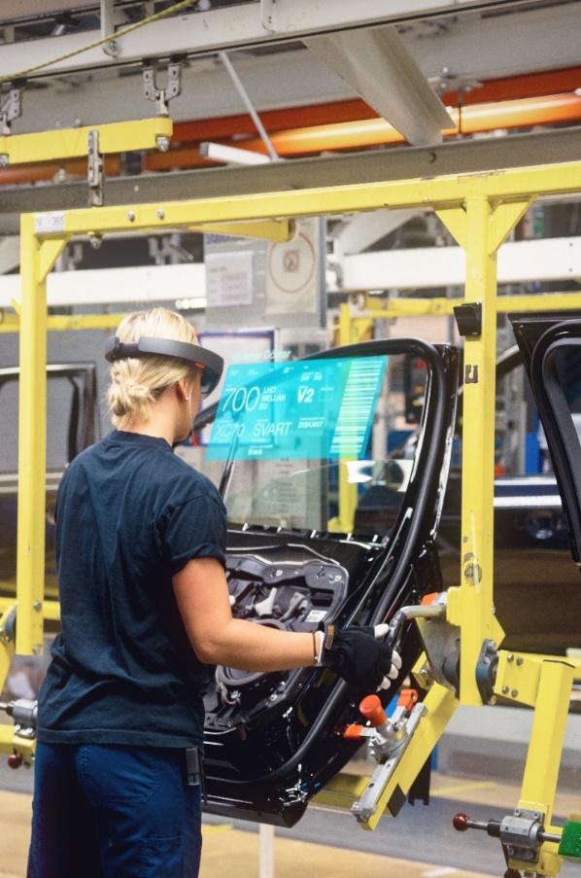

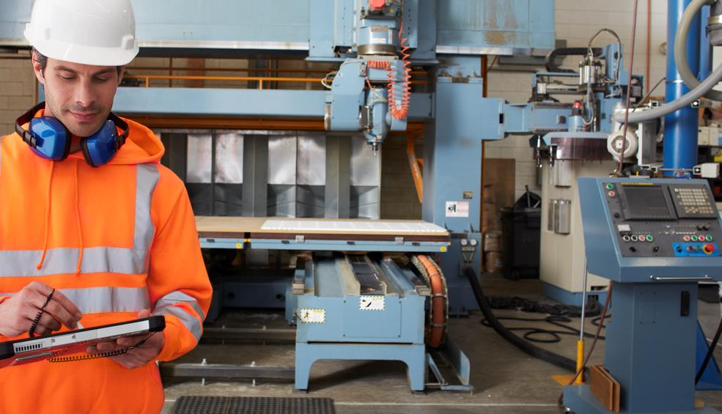
MANUFACTURING
MANUFACTURING
Predictive maintenance to eliminate unplanned downtime, increased efficiencies, new business models

Slide 7

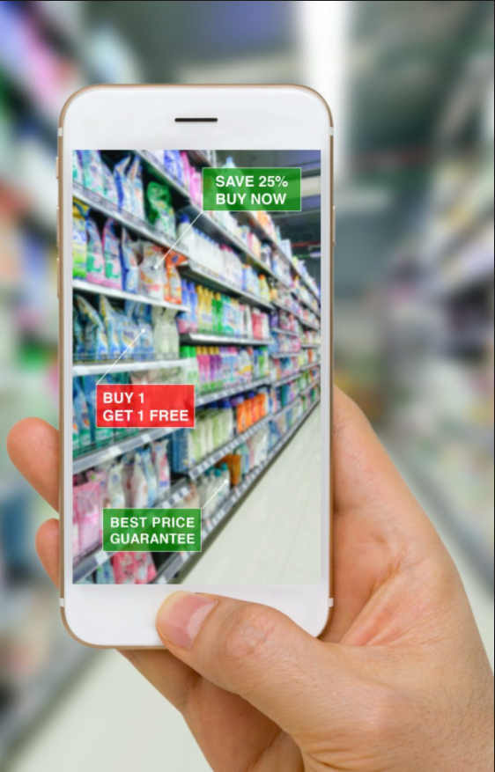




ENERGY
RETAIL
Better customer experiences,
new market opportunities

Slide 8



HEALTHCARE
HEALTHCARE
Improved quality and better outcomes for patients, anywhere

Slide 9

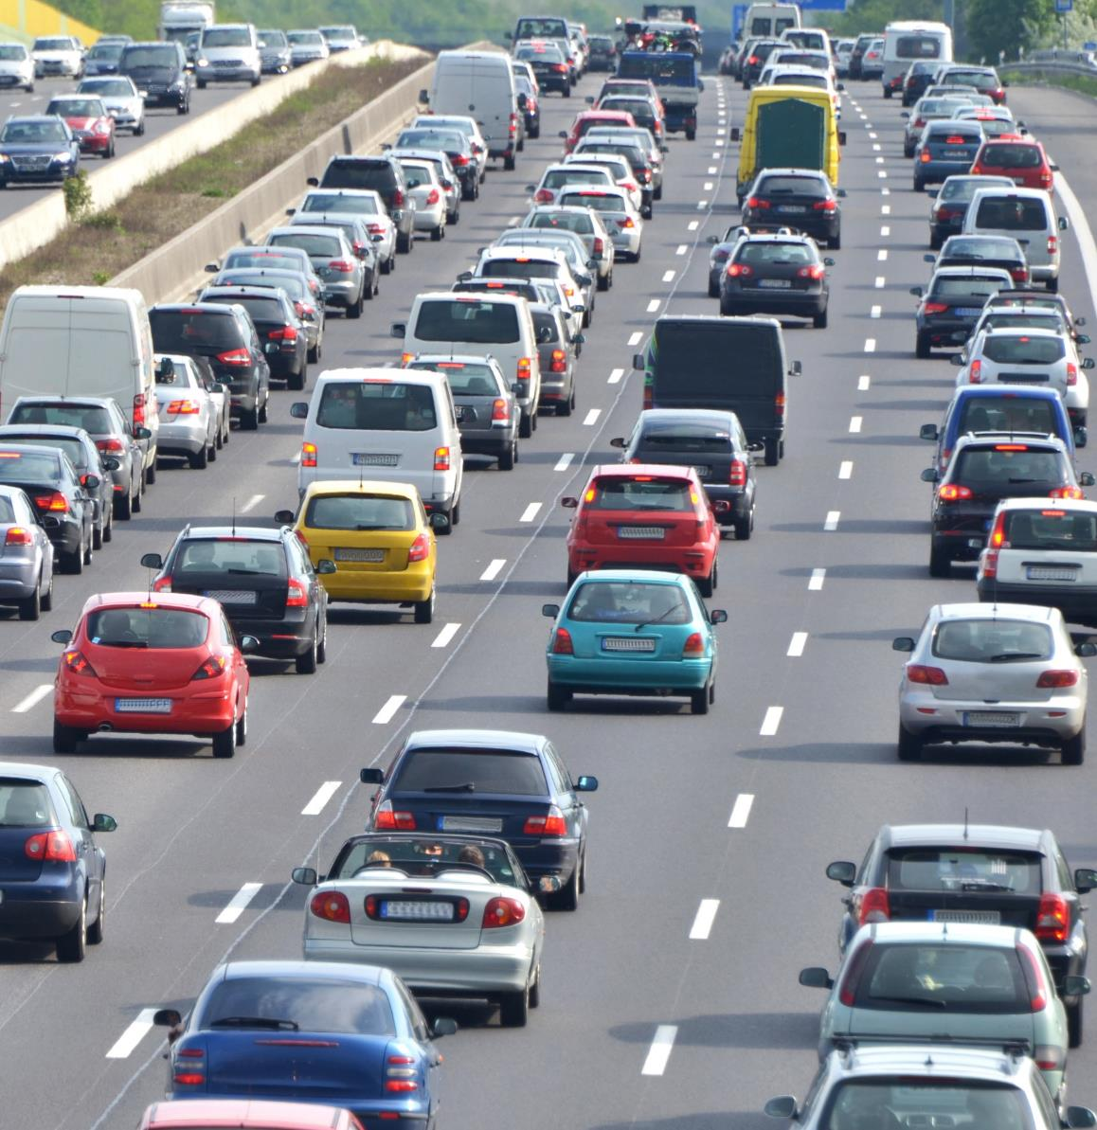


TRANSPORTATION
TRANSPORTATION
People and goods moving reliably, more safely, and using less energy

Slide 10
ENERGY
ENERGY
Reducing energy consumption and environmental impact

Slide 11

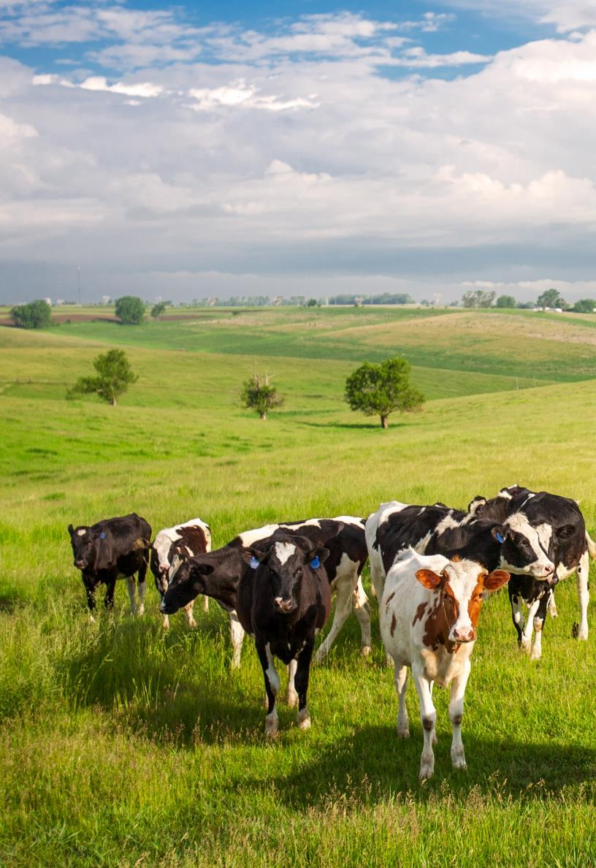
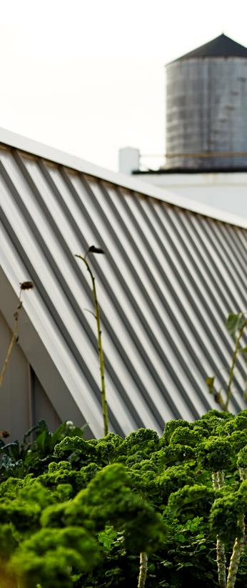

AGRICULTURE
AGRICULTURE
Better yields with lower environmental impact & natural resource usage

Slide 12



SMART CITIES
SMART CITIES
Smarter buildings, efficient infrastructure, increased safety & convenience

Slide 13
What is our unique approach?

Slide 14



What is our unique approach?
Universal Platform
Partnering
Persistence

Slide 15
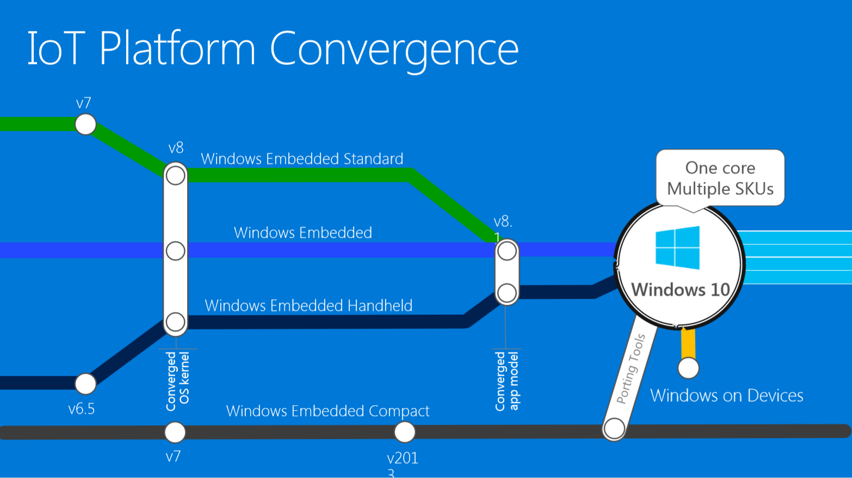

Slide 16
How we’re doing it.

Slide 17
A Simple View of an IoT Solution
Things
Insights
Actions

Slide 18
A More Realistic View…
Fault tolerance
Data storage
Deployment
Enterprise integration
Cloud-to-device commands
Business process integration
Cold path analytics
Device recovery
Solution scale
Operations monitoring
Cost management
Internationalization
High availability
Updating devices
Provisioning devices
Device lifecycle
Transport protocols
Warm path analytics
Drivers
Things
Disaster recovery
Insights
Hot path analytics
Actions
Device updates
Data ownership
< ---- End-to-End Security ---- >
On device analytics
Data visualization
HW certification
Manufacturing scale
Industry and government compliance
Device commercialization
… and why IoT needs simplifying
Securing data

Slide 19
Windows 10 IoT edition comparison
 | Windows 10 IoT Core |  | Windows 10 IoT Enterprise*
User experience | Single UWP app active in foreground at one time with supporting background apps & services |  | Traditional Windows shell with advanced lockdown features
Headless supported | Yes |  | Yes
App architecture supported | UWP only |  | UWP & Win32
Cortana | Yes |  | Yes
Management | Azure IoT DM, MDM |  | Azure IoT DM, MDM, traditional agent-based (e.g. SCCM)
Device security technologies | TPM, Secure Boot, BitLocker, Device Guard |  | TPM, Secure Boot, BitLocker, Device Guard
CPU architecture support | x86, x64, ARM32 |  | x86, x64
System resources | 512MB RAM + 2GB storage |  | 1GB RAM + 16GB storage**
Licensing | Online licensing terms agreement and embedded OEM agreements, royalty-free, subscription |  | Direct and indirect embedded OEM agreements
Usage scenarios | Digital signage & kiosks IoT gateway Manufacturing devices | Small medical devices Wearables Smart building | Digital signage & kiosks IoT gateway Manufacturing devices | Large medical devices Industry tablets POS, ATM
* Windows 10 IoT Enterprise is Windows 10 Enterprise with different licensing and distribution ** 2GB/20GB for 64-bit

Slide 20
Develop with IOT Core

Slide 21
Device Options?

Slide 22
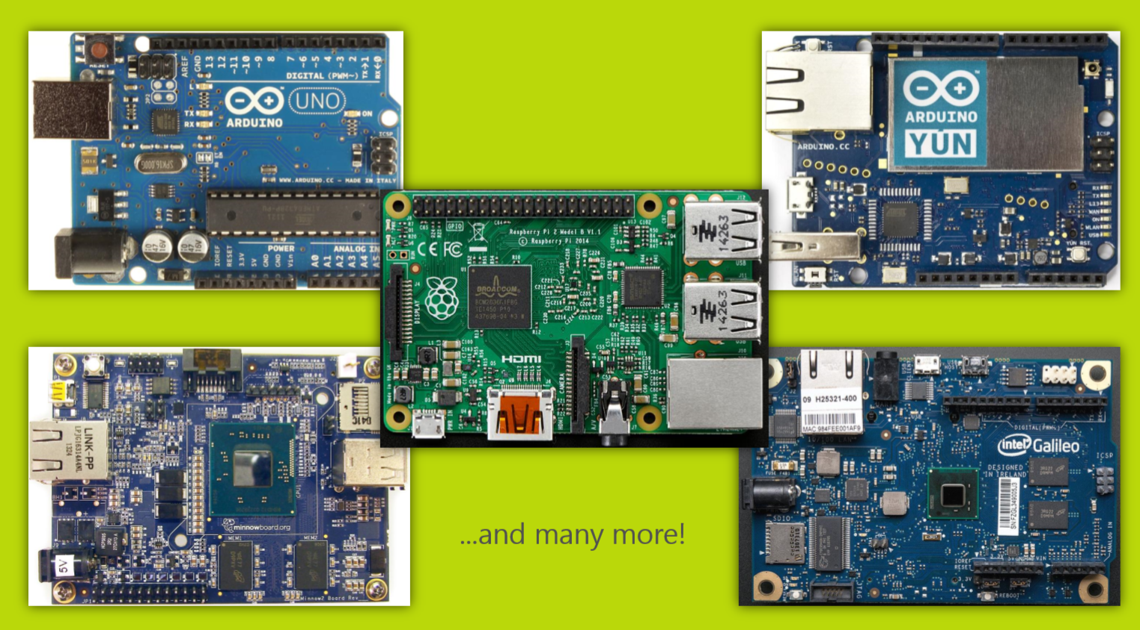

Slide 23
Dev Tools?

Slide 24
Tools to download
Windows 10 IOT Core
Widows 10 IOT Core Dashboard
Visual Studio 2017
Visual Studio Template for IOT Core

Slide 25
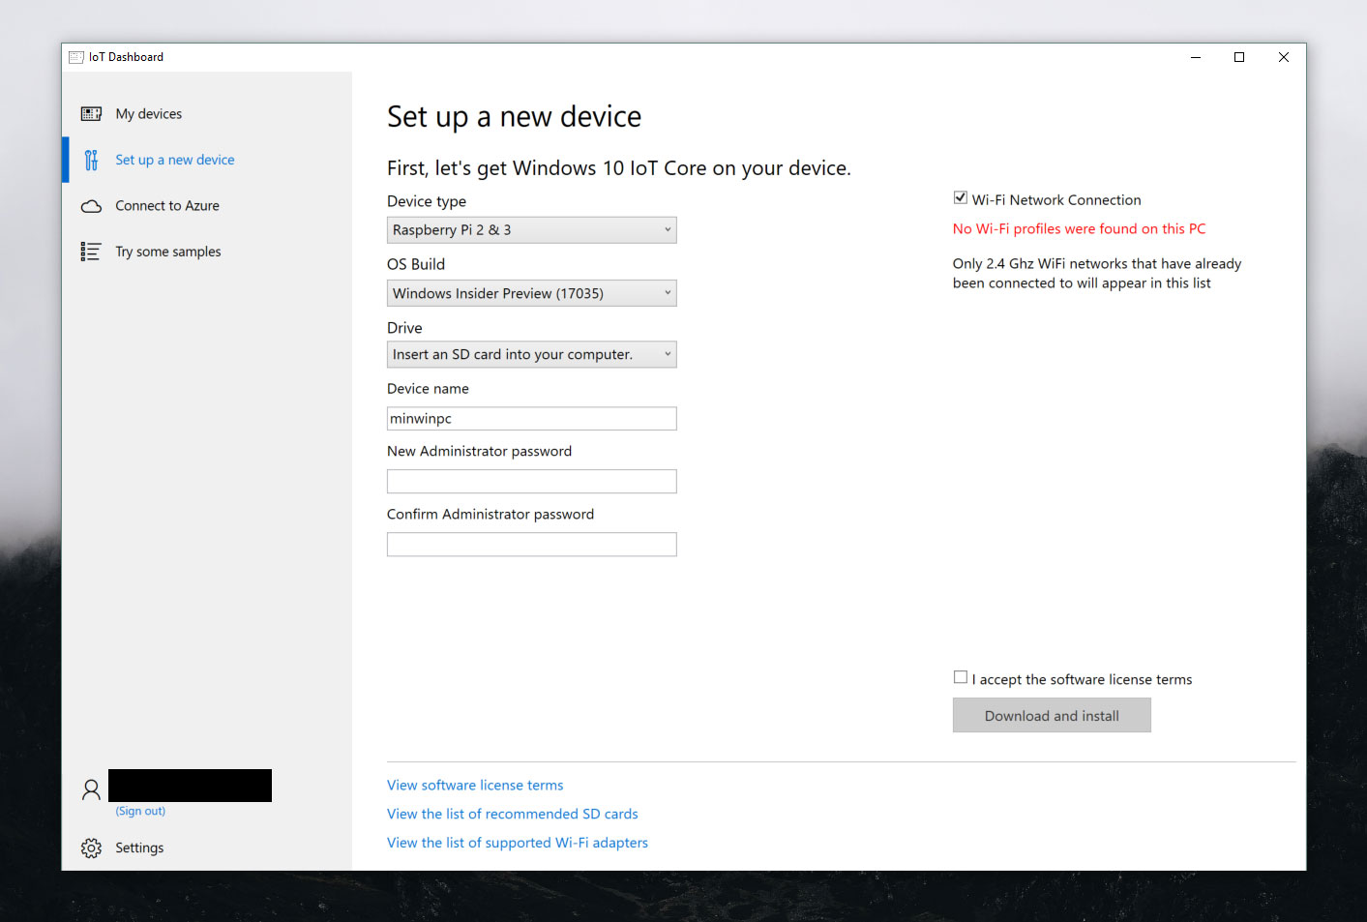

Slide 26
Develop with Visual Studio
Language Support: C#, C++, JavaScript
Hardware Requirement Any Windows IOT supported device

Slide 27
Demo

